Slide 1
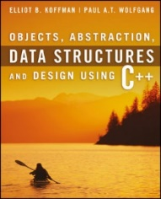
Welcome to
CS 235 Data Structures
Recursion, 7.1-2 (22)

Slide 2
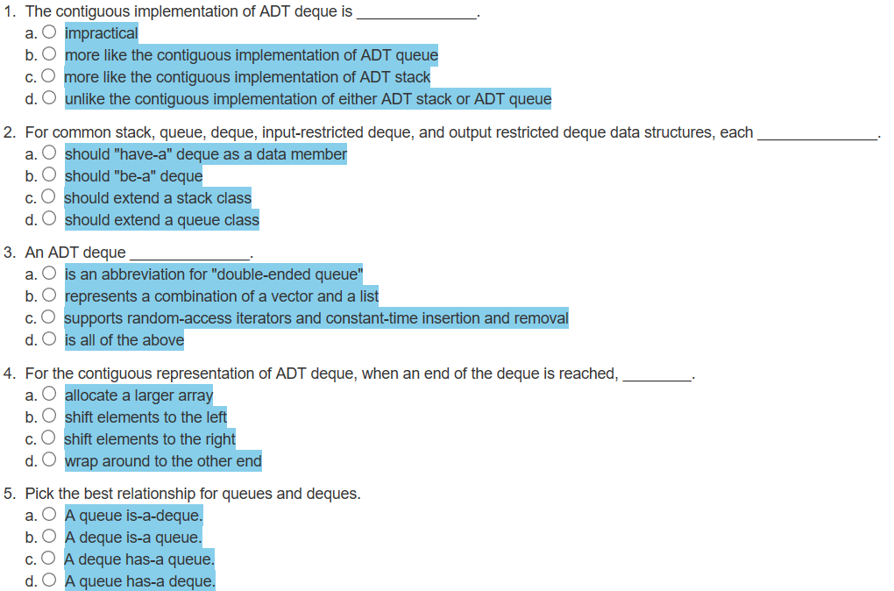
Attendance Quiz #21

Slide 3
Tip #22: = default; or { }
#include <iostream>
using namespace std;
class A
{
public:
A() {}
int i;
};
class B
{
public:
B() = default;
int i;
};
int main()
{
A a = A();
B b = B();
cout<< endl << "user-defined: " << a.i;
cout << endl << "default: " << b.i;
return 0;
}
The class B constructor defined with B() = default; is considered not-user defined.
This means the value-initialization
B b = B(); // () triggers value-initialization
is a special kind of initialization that doesn't use a normal constructor but results in a zero-initialization for built-in types.
The class A constructor defined by A() {} is considered user defined and no compiler generated constructor is called.
To value-initialize an object of type T means:
— if T is a (possibly cv-qualified) class type (Clause 9) with a user-provided constructor (12.1), then the default constructor for T is called (and the initialization is ill-formed if T has no accessible default constructor);
— if T is a (possibly cv-qualified) non-union class type without a user-provided constructor, then the object is zero-initialized and, if T’s implicitly-declared default constructor is non-trivial, that constructor is called.
— if T is an array type, then each element is value-initialized; — otherwise, the object is zero-initialized.
C++ Standard n3337 § 8.5/7.

Slide 4
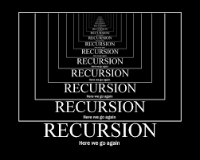
Chapter 7 Recursion

Slide 5
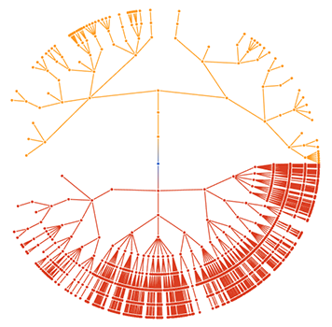
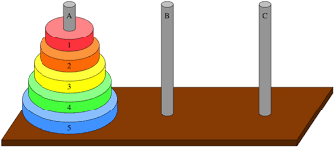
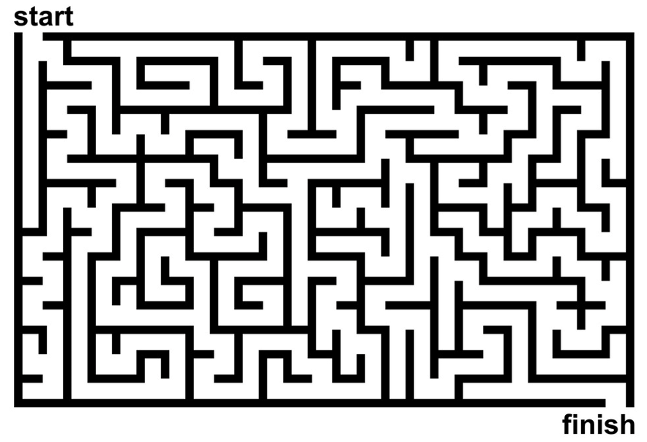
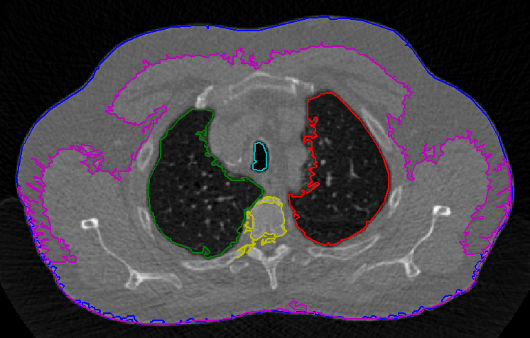
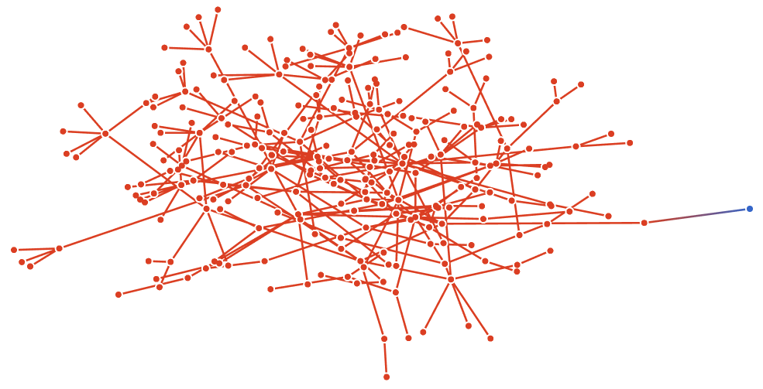
Objectives
To understand how to think recursively.
To learn how to trace a recursive function.
To learn how to write recursive algorithms and functions for searching vectors.
To understand how to use recursion to solve the Towers of Hanoi problem.
To understand how to use recursion to process two-dimensional images.
To learn how to apply backtracking to solve search problems such as finding a path through a maze.

Slide 6
Outcomes
Recursion can solve many programming problems that are difficult to conceptualize and solve linearly.
In the field of artificial intelligence, recursion often is used to write programs that exhibit intelligent behavior:
playing games of chess.
proving mathematical theorems.
recognizing patterns, and so on.
Recursive algorithms can
compute factorials.
compute a greatest common divisor.
find a path through a maze.
process data structures (strings, vectors, linked lists, etc.).
search efficiently using a binary search.

Slide 7
7.1 Recursive Thinking
Steps to Design a Recursive Algorithm
Proving That a Recursive Function Is Correct
Tracing a Recursive Function
The Stack and Activation Frames
7.1, pgs. 404-411

Slide 8
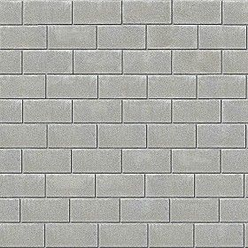
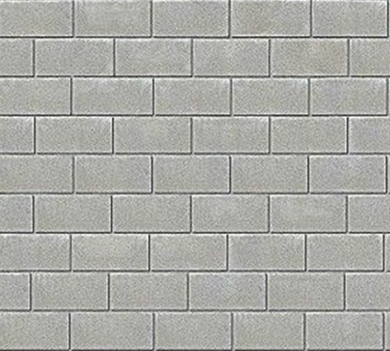
How To Build A 10-foot Wall?

Slide 9
Recursive Thinking
Recursion is a problem-solving approach that generates simpler solutions to certain kinds of problems that are difficult to solve by other means.
Recursion reduces a problem into one or more simpler versions of itself.
For example, consider searching for a target value in a sorted vector:
We compare the target to the middle element and, if the middle element does not match the target, search either the elements before the middle element or the elements after the middle element.
Instead of searching n elements, we search n/2 elements.
Find 23
2 | 5 | 8 | 12 | 16 | 23 | 38 | 56 | 72 | 91
23 > 16, 2nd half
2 | 5 | 8 | 12 | 16 | 23 | 38 | 56 | 72 | 91
23 < 56, 1st half
2 | 5 | 8 | 12 | 16 | 23 | 38 | 56 | 72 | 91
Found 23, Return 5
2 | 5 | 8 | 12 | 16 | 23 | 38 | 56 | 72 | 91

Slide 10
Recursive Thinking
General Recursive Algorithm:
Step 1 involves a test for what is called the base case: a value of n for which the problem can be solved easily
Whenever a split occurs, we revisit Step 1 for each new problem to see whether it is a base case or a recursive case
if problem can be solved directly for the current value of n
2. then Solve it.
else
3. Recursively apply the algorithm to one or more problems
involving smaller values of n.
4. Combine the solutions to the smaller problems to get the
solution to the original problem.
Because the value of n for each recursive case is smaller than the original value of n, each recursive case makes progress towards a base case
Step 3 is the recursive case, because there we recursively apply the algorithm

Slide 11
Design a Recursive Algorithm
Design:
Recognize a base case and provide a solution to it.
Devise a strategy to split the problem into smaller versions of itself while making progress toward a base case.
Combine the solutions to the smaller problems to solve the larger problem.
Find the length of a string:
/** Recursive function for length of string
@param str The string
@return The length of the string
*/
int size(string str)
{
}
if (str == "") return 0;
return 1 + size(str.substr(1));

Slide 12
Writing Recursive Algorithms
Write recursive functions to print a string of characters (space delimited) forward (Example: H e l l o) and reverse (Example: o l l e H).
Hint: Use string function str.at() and str.substr().
/** Recursive function print_chars
post: Display in forward order
@param str The string
*/
void print_chars(string str)
{
}
/** Recursive function print_chars_reverse
post: Display in reverse order
@param str The string
*/
void print_chars_reverse(string str)
{
}
Write recursive functions to return length and copy of strings:
/** Recursive function string_length
post: The string length is returned
@param str The string
*/
int string_length(string str)
{
}
/** Recursive function string_copy
post: str2 is copied to str1
@param str The string
*/
void string_copy(string& str1, string str2)
{
}

Slide 13
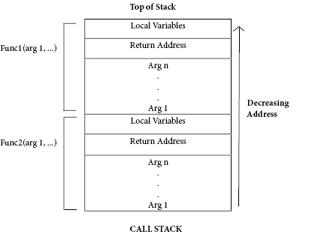
The Stack and Activation Frames
C++ maintains a stack on which it saves new information in the form of an activation frame.
The activation frame contains storage for
the return address of the calling function.
function arguments.
local variables (if any).
Whenever a new function is called (recursive or otherwise), C++ pushes a new activation frame onto the stack.

Slide 14
Tracing a Recursive Function
The process of returning from recursive calls and computing the partial results is called unwinding the recursion.
#include <iostream>
using namespace std;
int size(string str)
{
if (str == "") return 0;
return 1 + size(str.substr(1));
}
int main()
{
cout << size("ace");
return 0;
}
cout << size("ace");
3
return 1 + size("ce")
2
return 1 + size("e")
1
return 1 + size("")
0

Slide 15
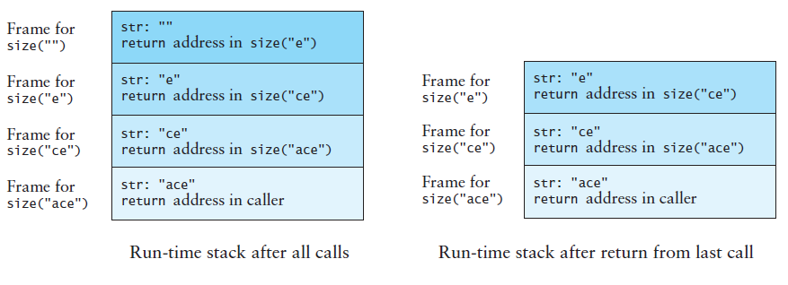
Run-Time Stack - Activation Frames
int main()
{
cout << size("ace");
return 0;
}
int size(string str)
{
if (str == "") return 0;
return size(str.substr(1));
}

Slide 16
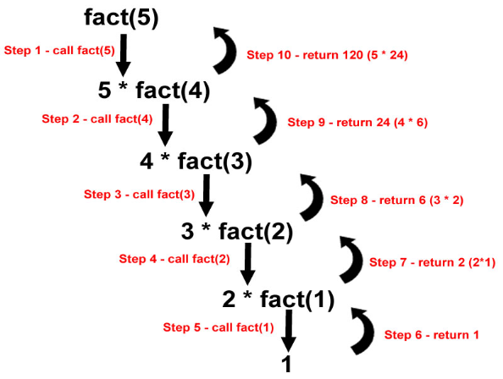
7.2 Recursive Definitions of Mathematical Formulas
Recursion Versus Iteration
Tail Recursion or Last-Line Recursion
Efficiency of Recursion
7.2, pgs. 412-419

Slide 17
Recursive Mathematical Formulas
Mathematicians often use recursive definitions of formulas that lead naturally to recursive algorithms
Examples include:
factorials
powers
greatest common divisors
sorts
x = factorial(4)
24
return 4 * factorial(3)
6
int factorial(int n)
{
if (n <= 1) return 1;
return (n * factorial(n – 1));
}
return 3 * factorial(2)
2
return 2 * factorial(1)
1

Slide 18
Calculating x^{n}
You can raise a number to a power that is greater than 0 by repeatedly multiplying the number by itself.
Recursive definition: x^{n} = x × x^{n-1}
Base case: x⁰ = 1
/** Recursive power function
@param x: The number
@param n: The exponent
@return x raised to the power n
*/
double power(double x, int n)
{
if (n == 0) return 1.0;
if (n > 0)
return x * power(x, n – 1);
else
return 1.0 / power(x, -n);
}
x = power(2.0, -3)
0.125
return 1.0 / power(2.0, 3)
8.0
return 2.0 * power(2.0, 2)
4.0
return 2.0 * power(2.0, 1)
2.0
return 2.0 * power(2.0, 0)
1.0

Slide 19
Trace the call stack of the following recursive Greatest-Common-Divisor function for gcd(30, 77).
/** Recursive Greatest Common Divisor function
@param m The larger number (m > 0)
@param n The smaller number (n > 0)
@return gcd of m and n
*/
int gcd(int m, int n)
{
if (m % n == 0) return n;
if (m < n) return gcd(n, m);
return gcd(n, m % n);
}
x = gcd(30, 77)
return |  | m |  | n
 | gcd( |  | , |  | )
 | gcd( |  | , |  | )
 | gcd( |  | , |  | )
 | gcd( |  | , |  | )
 | gcd( |  | , |  | )
 | gcd( |  | , |  | )

Slide 20
Calculating GCD Correct?
How do we verify that our algorithm is correct?
Base case correct?
The base case is “n is a divisor of m”
The solution is n (n is the greatest common divisor), which is correct
Does recursion make progress to base case?
Both arguments in each recursive call are smaller than in the previous call and
The new second argument is always smaller than the new first argument (m % n must be less than n)
Eventually a divisor will be found or the second argument will become 1 (which is a base case because it divides every integer)

Slide 21
Recursion Downside
Recursion downside
Base case never reached.
Factorial with a negative argument - throw an invalid_argument exception if n is negative.
You will eventually get a run-time error when there is no more memory available for your program to execute more function calls.
Error deep in recursion stack.
Recursion vs Iteration
There are similarities between recursion and iteration.
In iteration, a loop repetition condition determines whether to repeat the loop body or exit from the loop.
In recursion, the condition usually tests for a base case.
There is always an iterative solution to a problem that is solvable by recursion.
A recursive algorithm may be simpler than an iterative algorithm and thus easier to design, code, debug, and maintain.

Slide 22
Recursive Thinking
The concept of recursion and iteration is to execute a set of instructions repeatedly.
The difference is that with recursion the method being called is the same as the one making the call while iteration is when a loop is repeatedly executed until a certain condition is met.
Under the hood, both recursion and iteration depends on a condition so as to know when to stop but recursion is simply a process, always applied to a function.
Recursion is not intrinsically better or worse than loops—each has advantages and disadvantages.
Recursion and iteration are mutually translatable (in theory) and opinion-based.
Some tasks (like tree traversal) are better suited to recursion than others.
The implementation of the recursion may be simpler than the iterative solution, because it exploits a structural aspect of the problem in a way that the iterative approach cannot.
In a programming language that is not functional, an iterative approach is nearly always faster and more efficient than a recursive approach, so the reason to use recursion is clarity, not speed.

Slide 23
Tail Recursion
Most of the recursive algorithms and functions so far are examples of tail recursion or last-line recursion.
In these algorithms, there is a single recursive call and it is the last line of the function, such as in the factorial function.
Straightforward process to turn a recursion function with a tail into an iterative solution:
/** Recursive factorial function */
int factorial(int n)
{
if (n <= 1) return 1;
return n * factorial(n – 1);
}
/** Iterative factorial function */
int factorial_iter(int n)
{
int result = 1;
for (int k = 1; k <= n; k++)
result = result * k;
return result;
}

Slide 24
Be Safe

